Slide 1
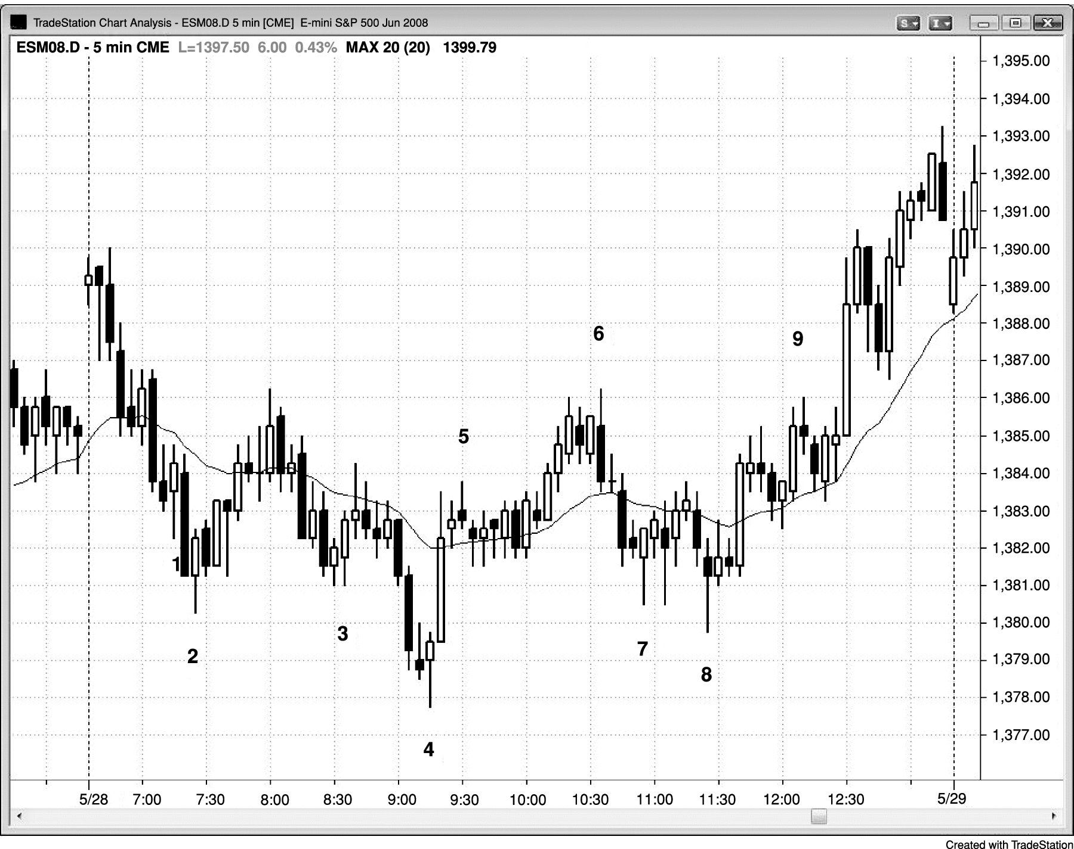
FIGURE 14.1 Moving Average Gaps, Second Signals

Slide 2
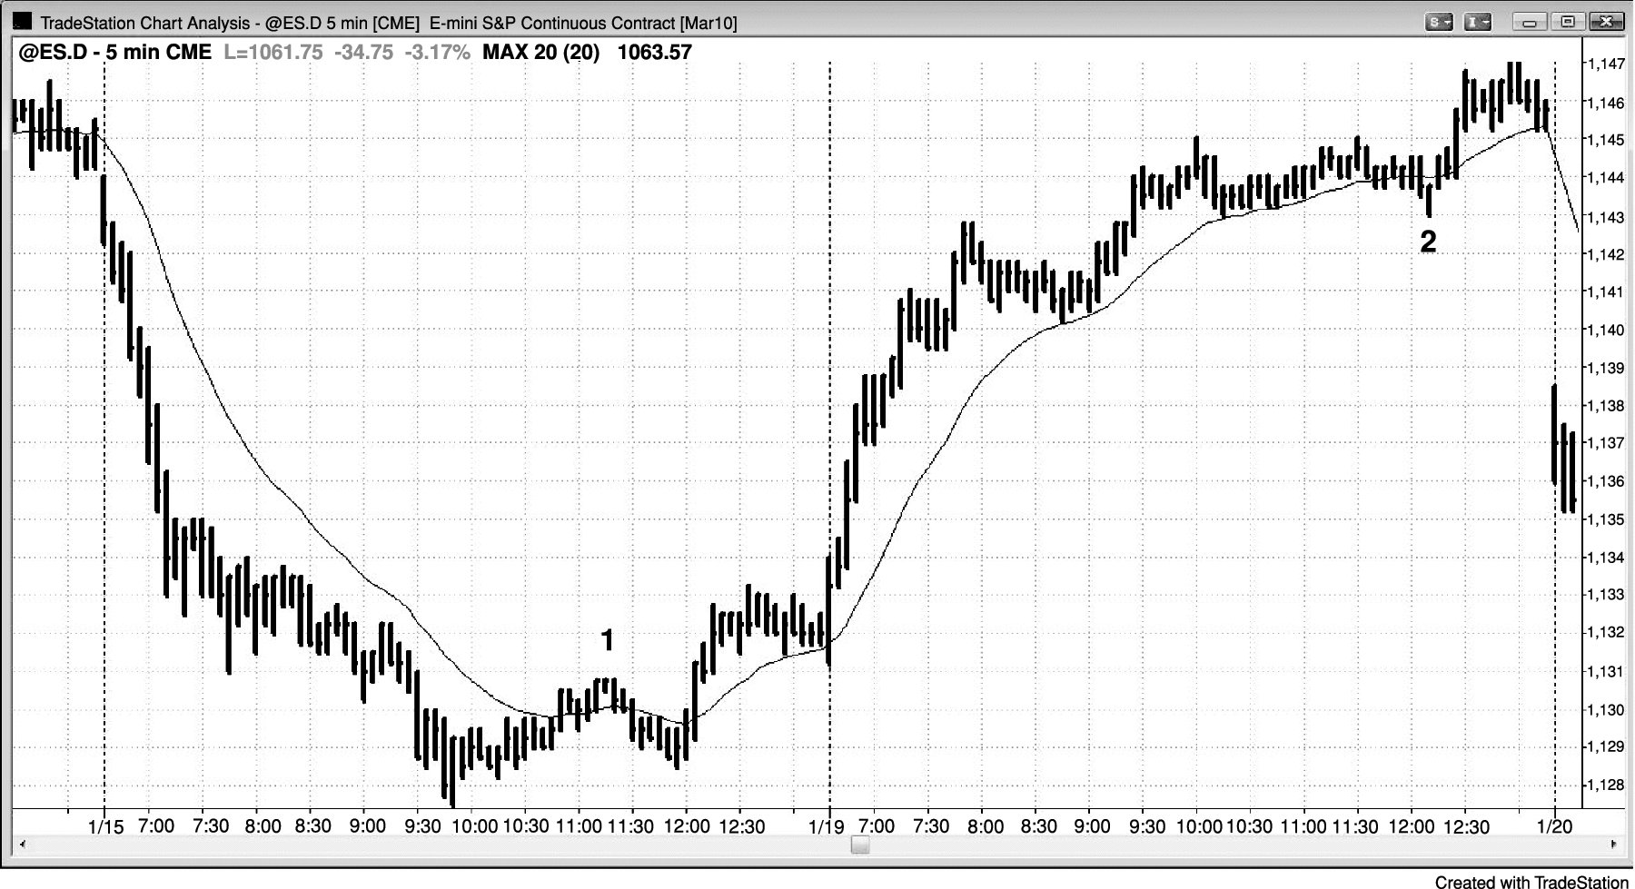
FIGURE 14.2 Moving Average Gap and Test of Extreme

